Slide 1
A Practical Approach to Timeseries Forecasting using Python
Overview of RNN Models
Important Parameters in Forecasting
Performance Analysis of LSTM
Performance Analysis of Bidirectional LSTM
Development of LSTM and Bi-LSTM Models for Time Series Forecasting
Shahzaib Hamid

Slide 2
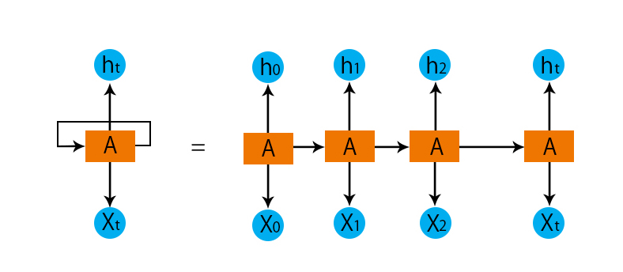
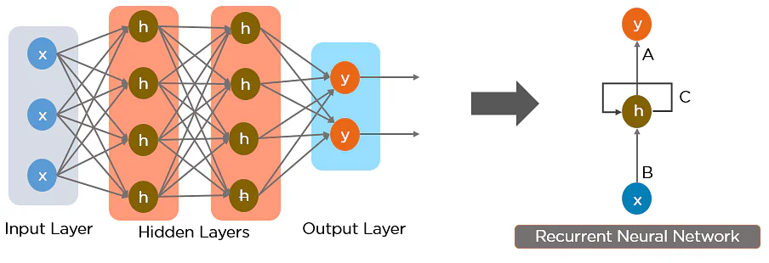
Overview of RNN Models
It can handle sequence dependencies.
RNN replaced Feed Forward Networks
The Major Issues of RNN

Slide 3
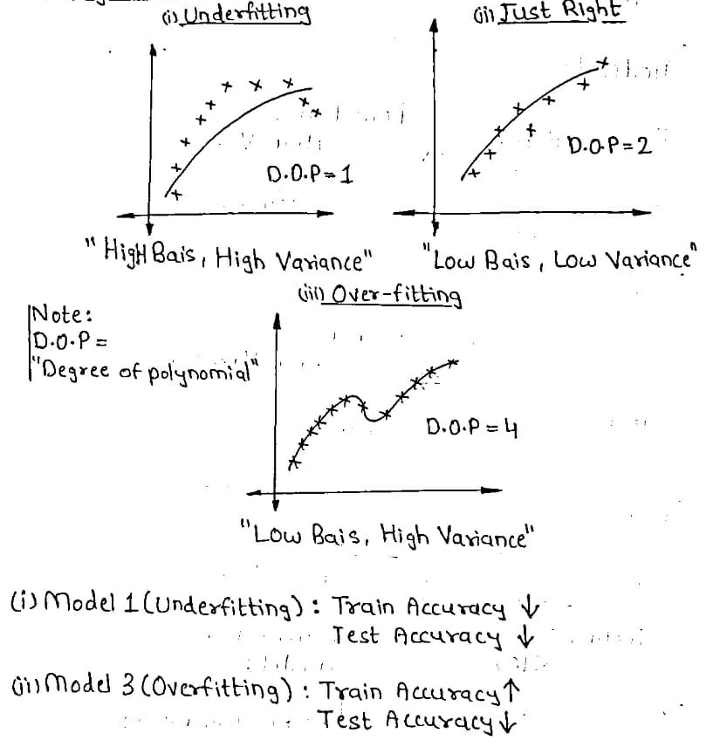
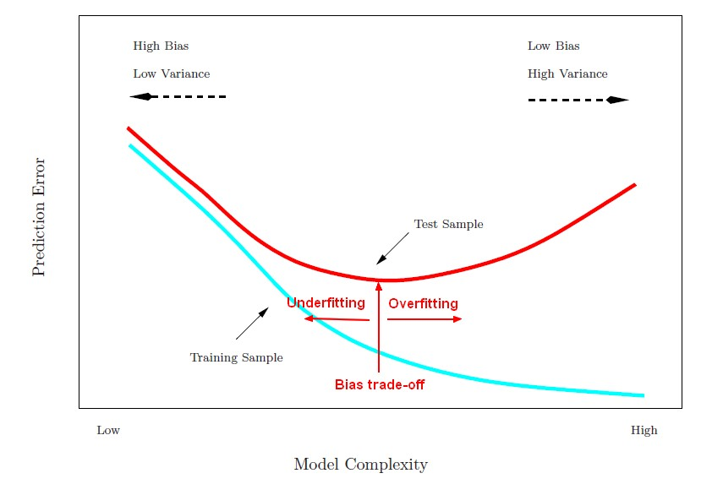
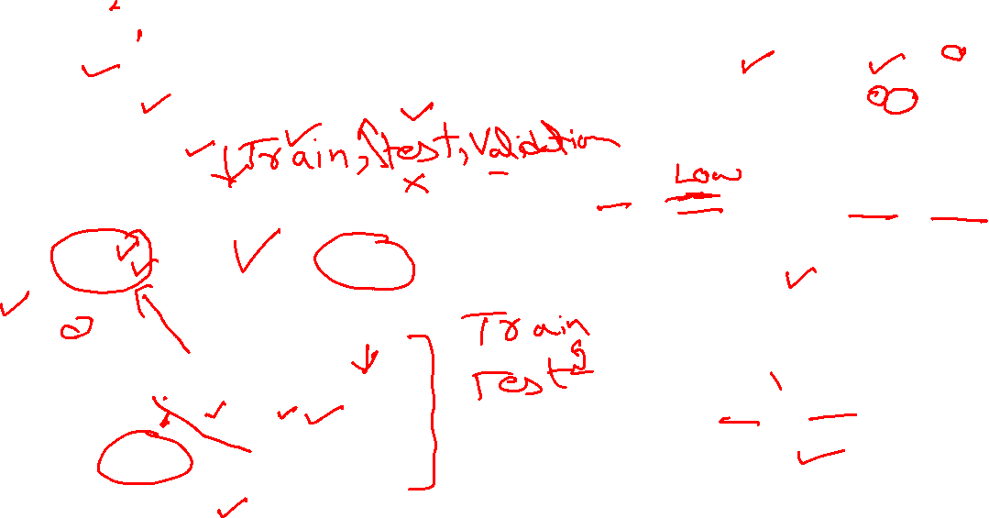
Important Parameters in Time Series Forecasting
Bias
Variance
Underfitting
Overfitting

Slide 4
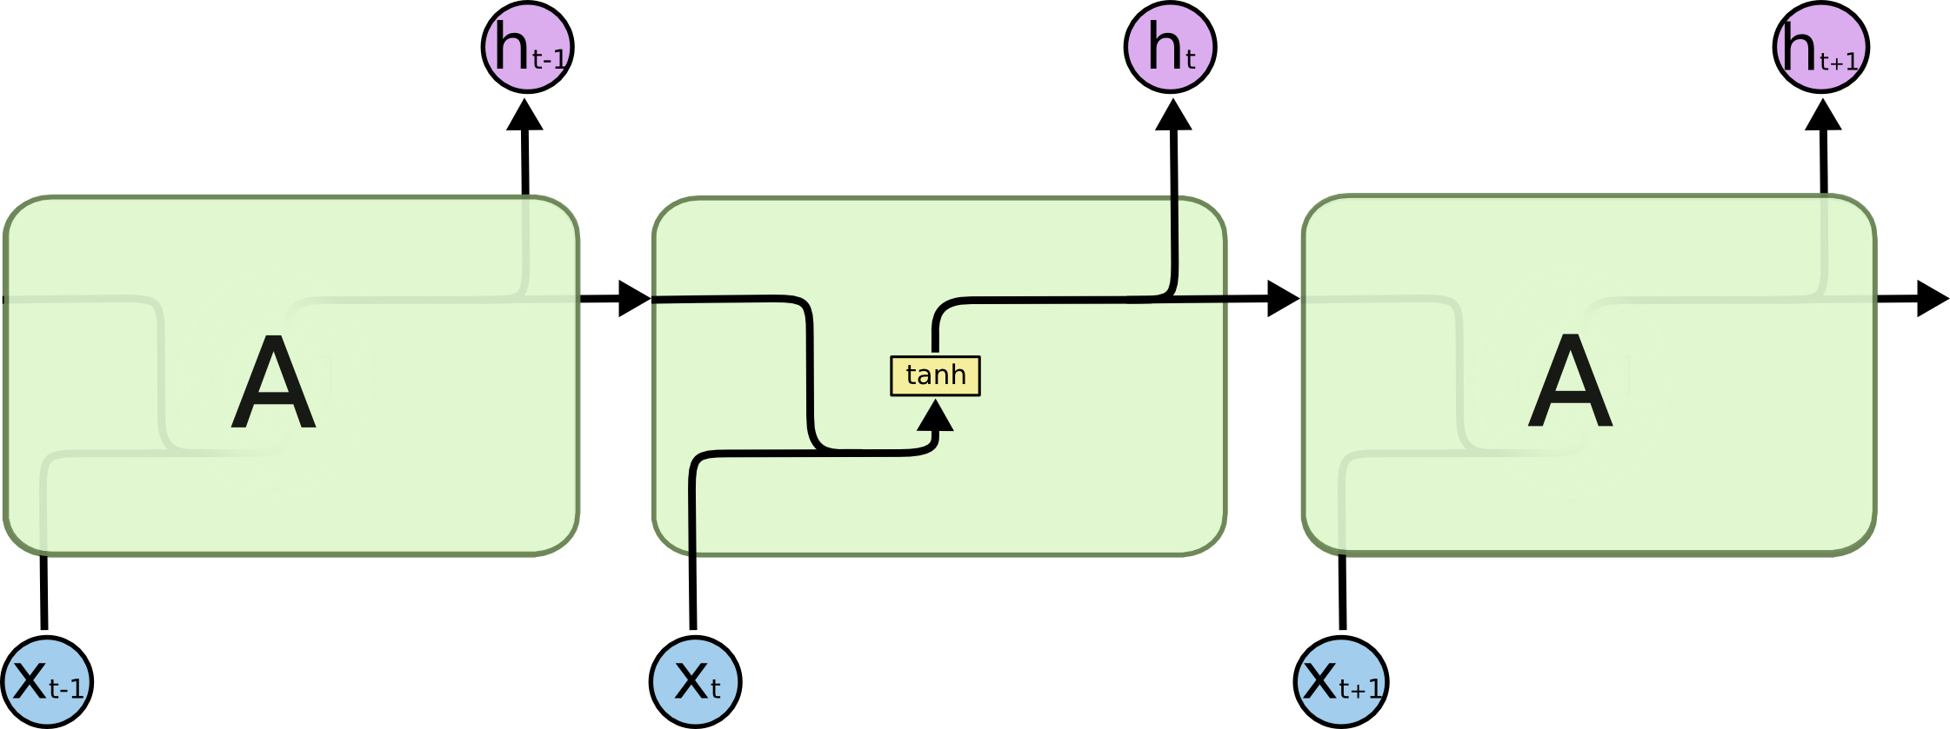
LSTM
First, Introduced in 1997
Designed to avoid the long-term dependency problem
Ease of Use
Ease of Customization

Slide 5
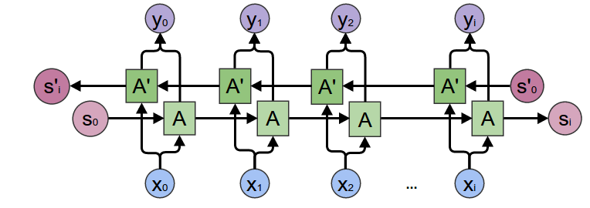
Bi-LSTM
Two independent RNNs together
Inputs run in two ways
Computationally Expensive
Not Suitable for Recognition systems

Slide 6
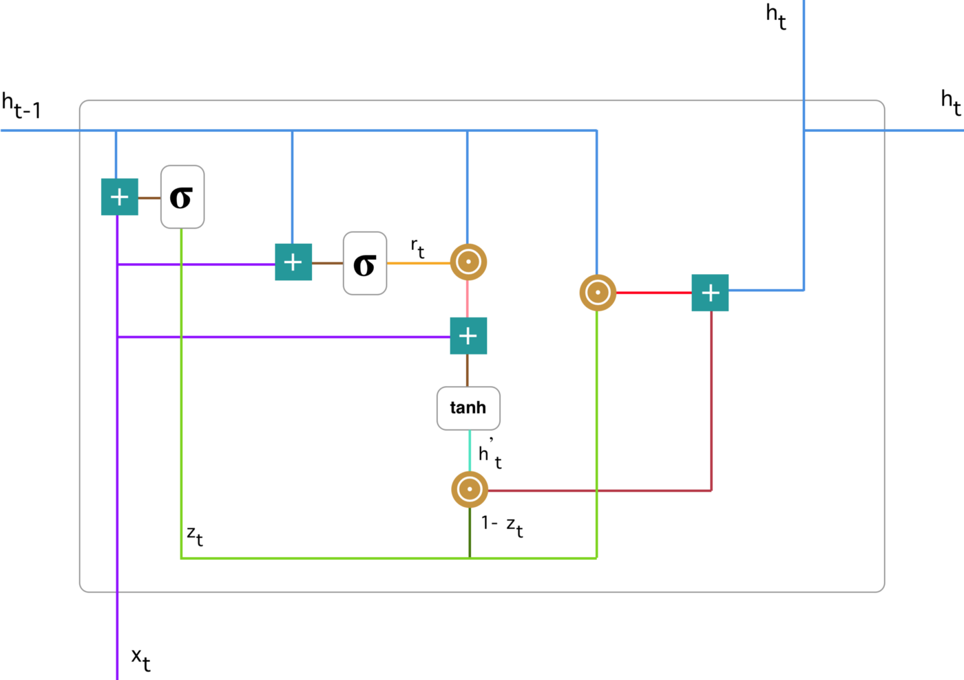
Gated Recurrent Unit (GRU)
In some cases: Better than LSTM
Computationally Cheaper and Fast
Has three main attributes, Update gate, Reset Gate, and current memory gate

Slide 7
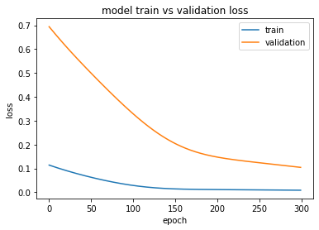
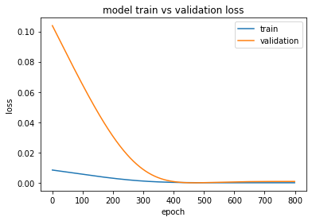
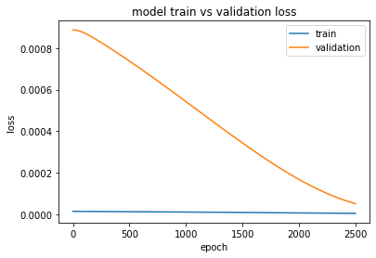
Underfitting and Overfitting
A model may be underfit if performance on the training set is better than the validation set
In Some cases, performance may be improved by increasing the capacity of the model

Slide 8
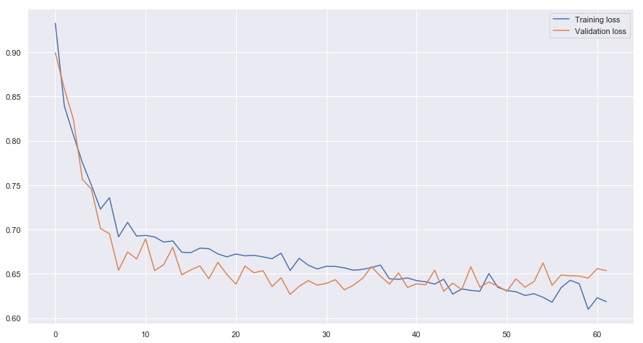
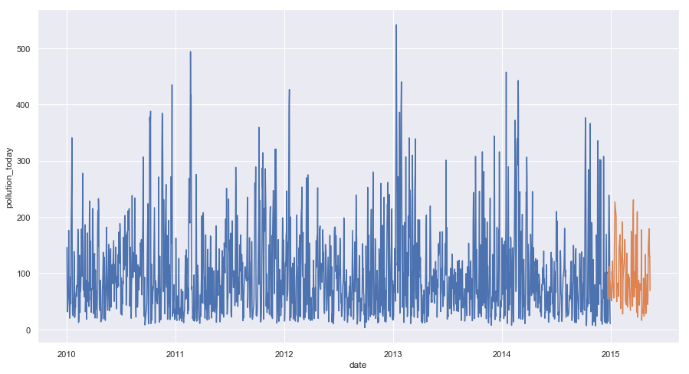
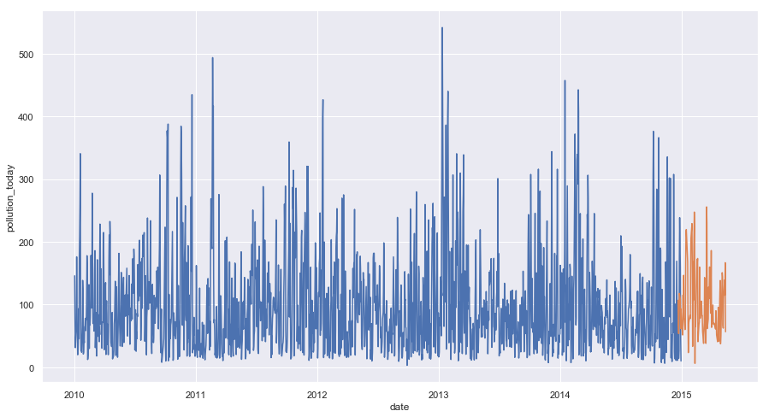
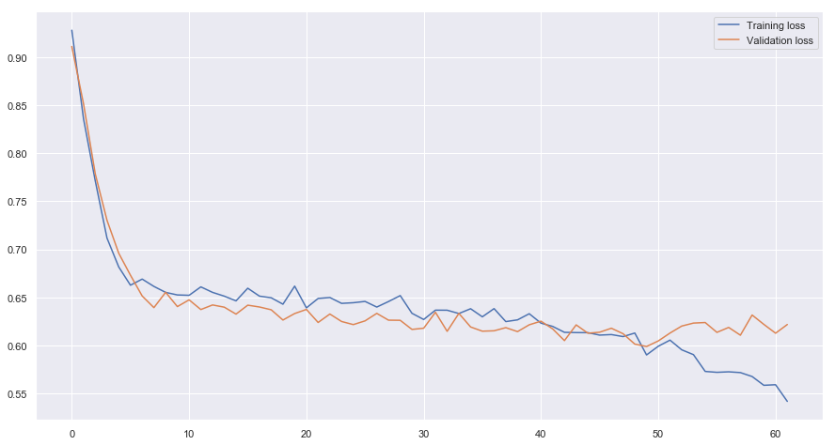
Development of LSTM and Bi-LSTM

